Slide 1

Media Bias for the Coronavirus
Project Proposal

Slide 2

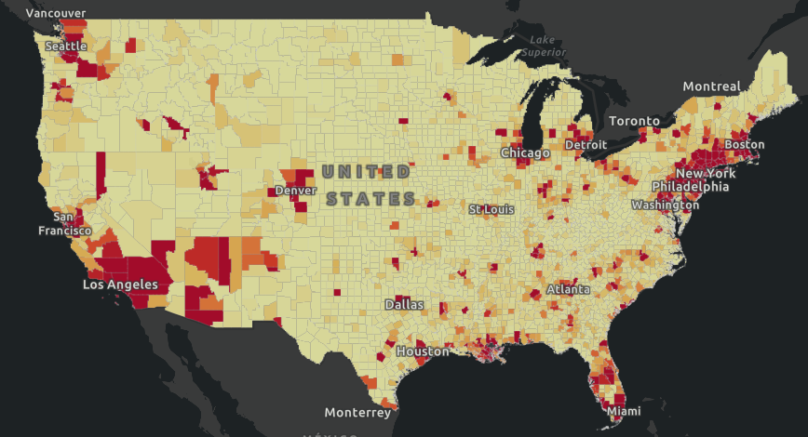
Coronavirus confirmed cases by State
State/territory | Confirmed cases | Governor Party | Senate Party
New York | 203020 | Democratic | Democratic
New Jersey | 68824 | Democratic | Democratic
Massachusetts | 28164 | Republican | Democratic
Michigan | 27001 | Democratic | Democratic
Pennsylvania | 25465 | Democratic | Both
California | 25356 | Democratic | Democratic
Illinois | 23248 | Democratic | Democratic
Florida | 21628 | Republican | Republican
Louisiana | 21518 | Democratic | Republican
Texas | 15006 | Republican | Republican
Democratic-leaning states have larger number of confirmed cases.

Slide 3

Social Distancing Measures
Bans on large gatherings
School closures
Restrictions on restaurant operations
Business closures
Stay-at-home orders
7 Republican States without Stay-at-home orders: Arkansas, Iowa, Nebraska, North Dakota, South Dakota, Utah, Wyoming

Slide 4

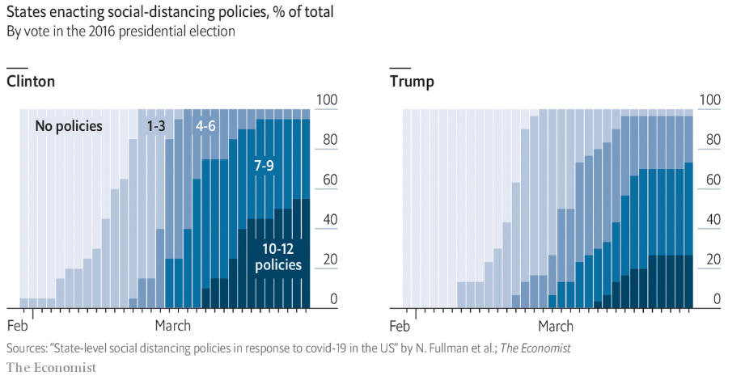
Social-Distancing Measures by State
A new paper by researchers at the University of Washington finds that
lawmakers in right-leaning states have been noticeably slower at rolling out social-distancing measures.

Slide 5
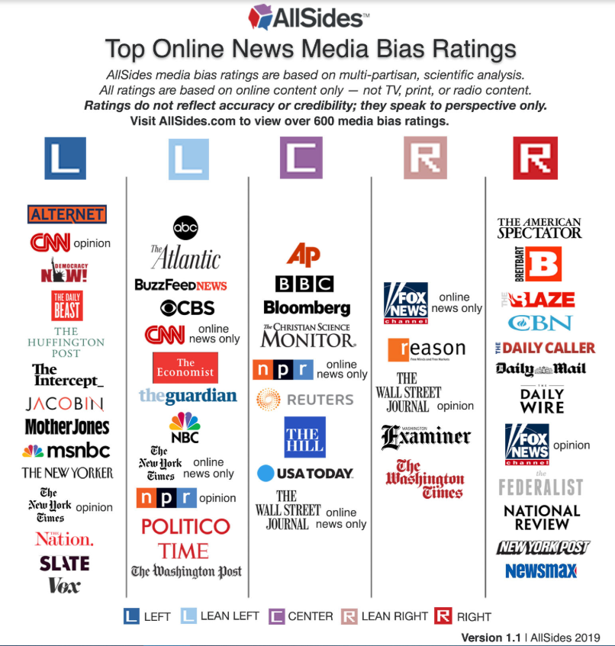
Media Bias for different news outlets
8 in 10 Fox News viewers say the media exaggerated the threat from coronavirus as compared to 54% of CNN viewers and just 35% of MSNBC watchers.

Slide 6

Research Question
How severe is the media bias in the news reporting about the coronavirus?
How does it influence people’s view of coronavirus and their actions towards it (like the enforcement of stay-at-home orders)?

Slide 7
Data Source and Collection
AllSites Media Bias Ratings have included 600 online news media and users' ratings.
News Articles: Using web-scarping tools to collect all news articles related to coronavirus in the last three months.
Twitter/Facebook:
Check the amount of retweets/likes/sharing these new articles have on social media platform

Slide 8
Data Analysis—News Reports
NLP sentiment analysis
Classify the articles based on their positive and negative views on different topics like coronavirus, stay-at-home orders, the president’s reaction to the pandemic…
Compare the results with the ratings from AllSites to see for the media sites: whether their different views of coronavirus comply with their left-right rating score?

Slide 9
Data Analysis—Social Media
Web-Scrapping Tweets/Facebook Posts in the past three months with hashtag #coronavirus, #stay-at-home……
NLP sentiment analysis by State
Classify the posts based on positive and negative views and then separate the results based on different State
Calculate number of repost/like/retweet/sharing of news articles and separate the results to get an average view by State

Slide 10
Implications of media bias
Although most states have issued stay-at-home orders, the enforcement of orders varies due to different views of the coronavirus.
Compare the number of violations of Stay-at-Home Orders with the news report bias and social media view for each state to see whether they have a correlation.

